Slide 1
PLANNING

Slide 2
Problems in Problem Solving
The problem solving agent can be overwhelmed by irrelevant action
Finding a good heuristic function
Problem solver might be inefficient because it cannot take advantage of problem decomposition.
Problems with search agent
  Too many actions and too many states to consider
  Heuristic function can only choose among states and can’t eliminate actions from consideration; so which action should be taken?
  Agent is forced to consider actions starting from the initial state.

Slide 3
Solutions to the problems
Planner is free to add actions to the plan wherever they are needed
  So it can make obvious and important decisions first, others later
Most parts of the world are independent of each other (nearly decomposable) -> so we can solve it independently (Div&Conq)
Open up the representation of states, goals, actions
  States and goals are represented by sets of sentences; actions by logical descriptions of preconditions and effects -> direct connections between states and actions

Slide 4
PLANNING
In which we see how an agent can take advantage of the structure of a problem to construct complex plans of action
The task of coming up with a sequence of actions that will achieve a goal is planning
Problem-solving agents are able to plan ahead before acting
They are different in representing goals, states, and actions, and in ways of constructing action sequences.

Slide 5
Basic representations
STRIPS language for efficient planning
  States are conjunctions of function-free ground literals
  At(P1,JFK)^At(P2,SFO)^Plane(P1)^Plane(P2)^...
  Goals are conjunctions of literals, contain variables
    At(C1,JFK)^At(C2,SFO)
  Implicit representations of states in planning - only changes are tracked.
  Actions in STRIPS have three components: action, precondition, and effect

Slide 6
Planning in STRIP language
Action(Fly(p, from, to),
PRECOND:At(p,from)^Plane(p)^Airport(from)^Airport(to)
EFFECT:!At(p,from)^At(p,to))
The above is an action schema
An action schema consists of 3 parts
  Action name and parameter
  Precondition – a conjunction of function-free positive literals stating what must be true in a state before the action can be executed
  Effect – a conjunction of function-free literals describing how the state changes when the action is executed.

Slide 7
Planning with State-Space Search
Two approaches to search
  An example of Fly
  Forward state-space search -progression planning
    Starting with the initial state, actions, goal test
  Backward state-space search – regression planning
    Starting with the goal state, applying only relevant actions
    For actions that achieve some desired literal, the actions should not undo any desired literals (Consistency)

Slide 8
Continued…
A plan is complete if every precondition of every step is achieved by some other step.
  A step achieves a condition if the condition is one of the effects of the step.
  The causal link to protect a precond
A plan is consistent if there are no contradictions in the ordering or binding constraints.
  Ordering is transitive

Slide 9
Example: blocks world (Sussman anomaly)
Initial:
Goal:
A
C
B
A
B
C
State I: on-table(A)^ on(C,A) ^on-table(B)^(clear B) ^ (clear C)
Goal: on(A,B)^ on(B,C)

Slide 10
Nets Of Action Hierarchies
on(a, b)
S
J
on(b, c)
clear(a)
S
J
puton(a, b)
clear(b)
S
J
clear(b)
S
J
puton(b, c)
clear(c)

Slide 11
Nets Of Action Hierarchies
on(a, b)
S
J
on(b, c)
clear(a)
S
J
puton(a, b)
clear(b)
S
J
clear(b)
S
J
puton(b, c)
clear(c)

Slide 12
Resolve conflicts ‘critic’:
clear(a)
S
J
puton(a, b)
clear(b)
S
J
clear(b)
S
J
puton(b, c)
clear(c)
clear(a)
S
J
puton(a, b)
clear(b)
S
J
clear(b)
S
J
puton(b, c)
clear(c)

Slide 13
clear(a)
S
J
puton(a, b)
clear(b)
S
J
clear(b)
S
J
puton(b, c)
clear(c)
clear(a)
J
puton(a, b)
S
clear(b)
S
J
puton(b, c)
clear(c)

Slide 14
clear(a)
J
puton(a, b)
S
clear(b)
S
J
puton(b, c)
clear(c)
clear(c)
puton(c, X)
J
puton(a, b)
S
clear(b)
S
J
puton(b, c)
clear(c)

Slide 15
Final plan
clear(c)
puton(c, X)
J
puton(b, c)
puton(a, b)
S
clear(b)

Slide 16
Partial-order planning
It’s nondeterministic
It starts with a minimal partial plan.
It satisfies one precond at a time.
POP is a regression planner.
POP is sound and complete.

Slide 17
Heuristics for POP
POP does not represent states directly, so it is harder to estimate how far a POP is from achieving a goal
Heuristics are needed to choose which plan to refine
Heuristic 1: to count the number of distinct open preconditions
Heuristic 2: the most-constrained-variable

Slide 18
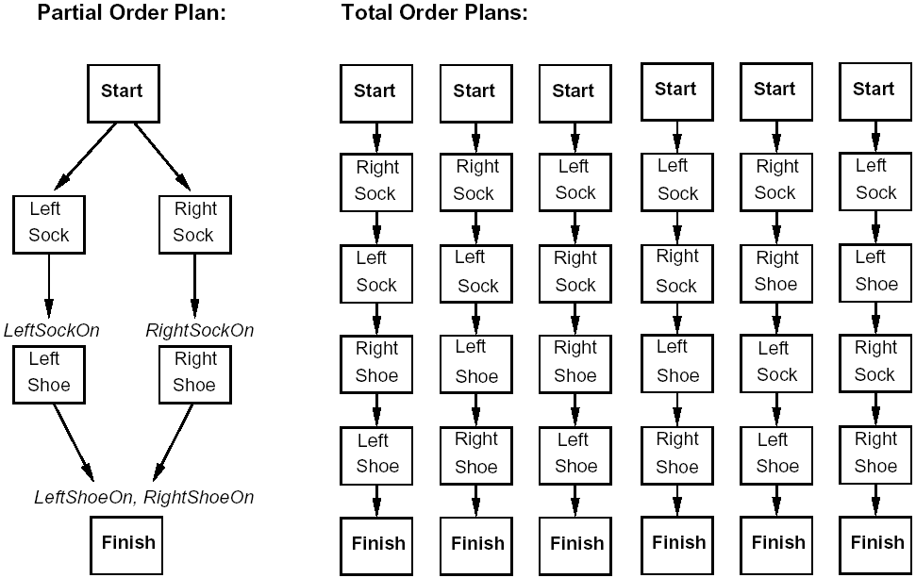
Total-Order vs Partial-Order Plans

Slide 19
Plan Generation: Search space of plans
Partial-Order Planning (POP)
Nodes are partial plans
Arcs/Transitions are plan refinements
Solution is a node (not a path).
Principle of “Least commitment”
e.g. do not commit to an order of actions until it is required

Slide 20
Partial Plan Representation
Plan = (A, O, L), where
  A: set of actions in the plan
  O: temporal orderings between actions (a < b)
  L: causal links linking actions via a literal
Causal Link:
Action Ac (consumer) has precondition Q that is established in the plan by Ap (producer).
move-a-from-b-to-table move-c-from-d-to-b
Q
Ap
Ac
(clear b)

Slide 21
POP
POP is sound and complete
POP Plan is a solution if:
  All preconditions are supported (by causal links), i.e., no open conditions.
  No threats
  Consistent temporal ordering
By construction, the POP algorithm reaches a solution plan

Slide 22
POP example: Sussman Anomaly
A0
(on C A)
(on-table A)
(on-table B)
(clear C)
(clear B)
(on A B)
(on B C)
Ainf

Slide 23
Work on open precondition (on B C) and (clear B)
A0
(on C A)
(on-table A)
(on-table B)
(clear C)
(clear B)
(clear B)
(clear C)
(on-table B)
A1: move B from Table to C
-(on-table B)
-(clear C)
(on B C)
(on A B)
(on B C)
Ainf

Slide 24
Work on open precondition (on A B)
A0
(on C A)
(on-table A)
(on-table B)
(clear C)
(clear B)
(clear B)
(clear C)
(on-table B)
(clear A)
(clear B)
(on-table A)
A1: move B from Table to C
A2: move A from Table to B
-(on-table B)
-(clear C)
(on B C)
-(on-table A)
-(clear B)
(on A B)
(on A B)
(on B C)
Ainf

Slide 25
Protect causal links
A0
(on C A)
(on-table A)
(on-table B)
(clear C)
(clear B)
(A0, (clear B), A1) theatened by A2
--> Promotion
(clear B)
(clear C)
(on-table B)
(clear A)
(clear B)
(on-table A)
A1: move B from Table to C
A2: move A from Table to B
-(on-table B)
-(clear C)
(on B C)
-(on-table A)
-(clear B)
(on A B)
(on A B)
(on B C)
Ainf

Slide 26
Work on open precondition (clear A) and protect links
A0
(on C A)
(on-table A)
(on-table B)
(clear C)
(clear B)
(on C A)
(clear C)
A3: move C from A to Table
-(on C A)
(on-table C)
(clear A)
(clear B)
(clear C)
(on-table B)
(clear A)
(clear B)
(on-table A)
A1: move B from Table to C
A2: move A from Table to B
-(on-table B)
-(clear C)
(on B C)
-(on-table A)
-(clear B)
(on A B)
(on A B)
(on B C)
Ainf

Slide 27
Final plan
A0
(on C A)
(on-table A)
(on-table B)
(clear C)
(clear B)
(on C A)
(clear C)
A3: move C from A to Table
-(on C A)
(on-table C)
(clear A)
(clear B)
(clear C)
(on-table B)
(clear A)
(clear B)
(on-table A)
A1: move B from Table to C
A2: move A from Table to B
-(on-table B)
-(clear C)
(on B C)
-(on-table A)
-(clear B)
(on A B)
(on A B)
(on B C)
Ainf

Slide 28
Summary
Planning uses more flexible representations of state, actions, goals, and plans
STRIPS - a specific language that connects states to actions (action, precond, effect); there are other languages like ADL (action description lang)
Search through the plan space - regression
Least commitment: partial ordering & instantiation
Causal links: protect rewriting & detect conflicts early

Slide 29
Hierarchical Task Network (HTN) Planning

Slide 30
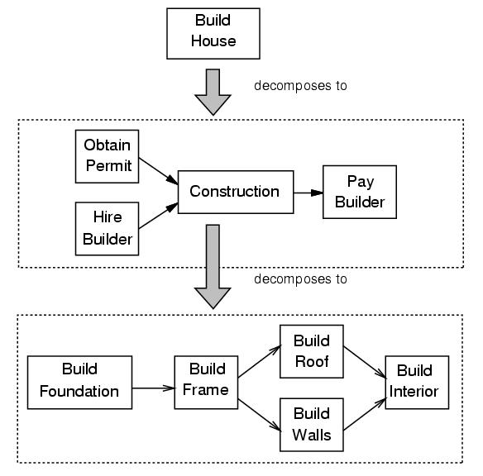
Hierarchical Decomposition

Slide 31
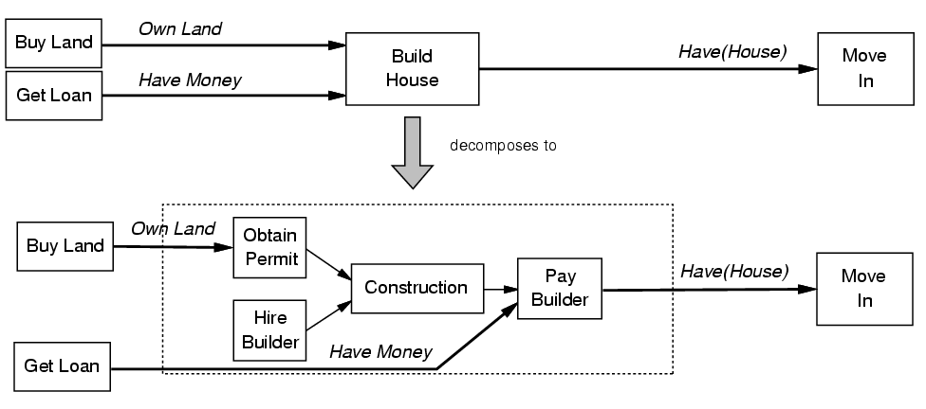
Task Reduction

Slide 32
HTN Planning
Capture hierarchical structure of the planning domain
Planning domain contains non-primitive actions and schemas for reducing them
Reduction schemas:
  given by the designer
  express preferred ways to accomplish a task

Slide 33
HTN Planning Algorithm
Problem reduction:
Decompose tasks into subtasks
Handle constraints
Resolve interactions
If necessary, backtrack and try other decompositions

Slide 34
Basic HTN Procedure
Input a planning problem P
If P contains only primitive tasks, then resolve the conflicts and return the result. If the conflicts cannot be resolved, return failure
Choose a non-primitive task t in P
Choose an expansion for t
Replace t with the expansion
Find interactions among tasks in P and suggest ways to handle them. Choose one.
Go to 2

Slide 35
Planning Graphs
Construct a graph that encodes constraints on possible plans
Use this “planning graph” to constrain search for a valid plan:
  If valid plan exists, it’s a subgraph of the planning graph
Planning graph can be built for each problem in polynomial time

Slide 36
Problem handled by GraphPlan*
Pure STRIPS operators:
  conjunctive preconditions
  no negated preconditions
  no conditional effects
  no universal effects
Finds “shortest parallel plan”
Sound, complete and will terminate with failure if there is no plan.

Slide 37
Planning graph
Directed, leveled graph
  2 types of nodes:
    Proposition: P
    Action: A
  3 types of edges (between levels)
    Precondition: P -> A
    Add: A -> P
    Delete: A -> P
Proposition and action levels alternate
Action level includes actions whose preconditions are satisfied in previous level plus no-op actions (to solve frame problem).

Slide 38
Planning graph
…
…
…

Slide 39
Constructing the planning graph
Level P₁: all literals from the initial state
Add an action in level A_{i} if all its preconditions are present in level P_{i}
Add a precondition in level P_{i} if it is the effect of some action in level A_{i-1} (including no-ops)
Maintain a set of exclusion relations to eliminate incompatible propositions and actions (thus reducing the graph size)
P₁ A₁ P₂ A₂ … P_{n-1} A_{n-1} P_{n}

Slide 40
Mutual Exclusion relations
Two actions (or literals) are mutually exclusive (mutex) at some stage if no valid plan could contain both.
Two actions are mutex if:
  Interference: one clobbers others’ effect or precondition
  Competing needs: mutex preconditions
Two propositions are mutex if:
  All ways of achieving them are mutex

Slide 41
GraphPlan algorithm
Grow the planning graph (PG) until all goals are reachable and not mutex. (If PG levels off first, fail)
Search the PG for a valid plan
If not found, add a level to the PG and try again

Slide 42
Searching for a solution plan
Backward chain on the planning graph
Achieve goals level by level
At level k, pick a subset of non-mutex actions to achieve current goals. Their preconditions become the goals for k-1 level.
Build goal subset by picking each goal and choosing an action to add. Use one already selected if possible. Do forward checking on remaining goals (backtrack if can’t pick non-mutex action)

Slide 43
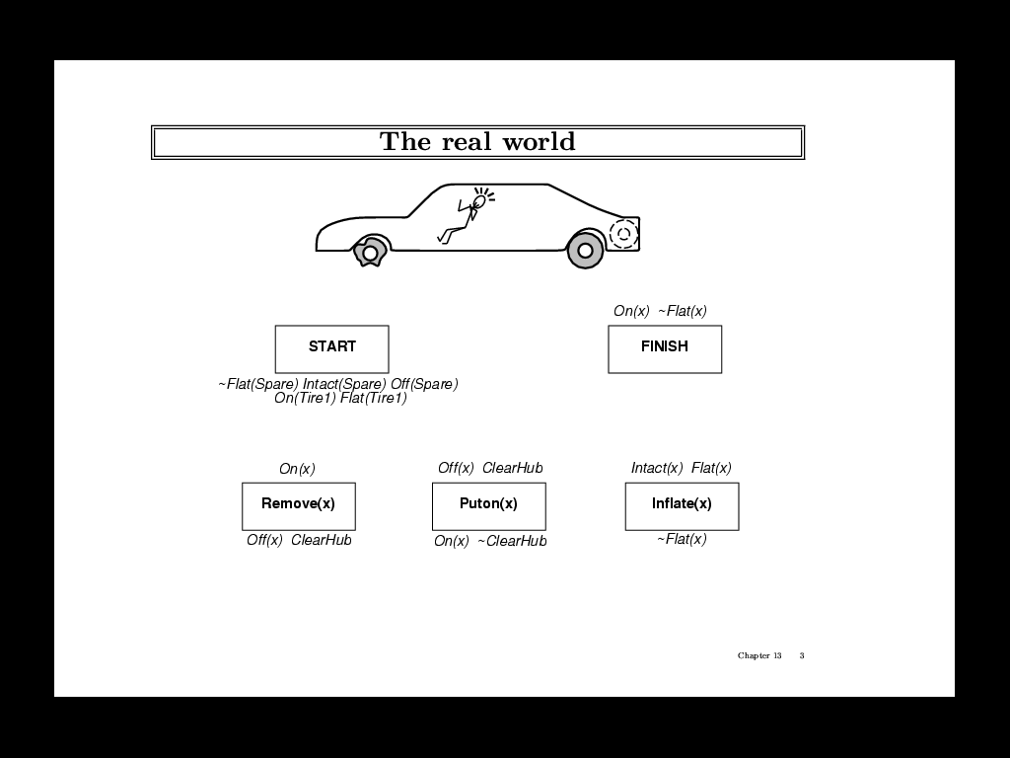

Slide 44
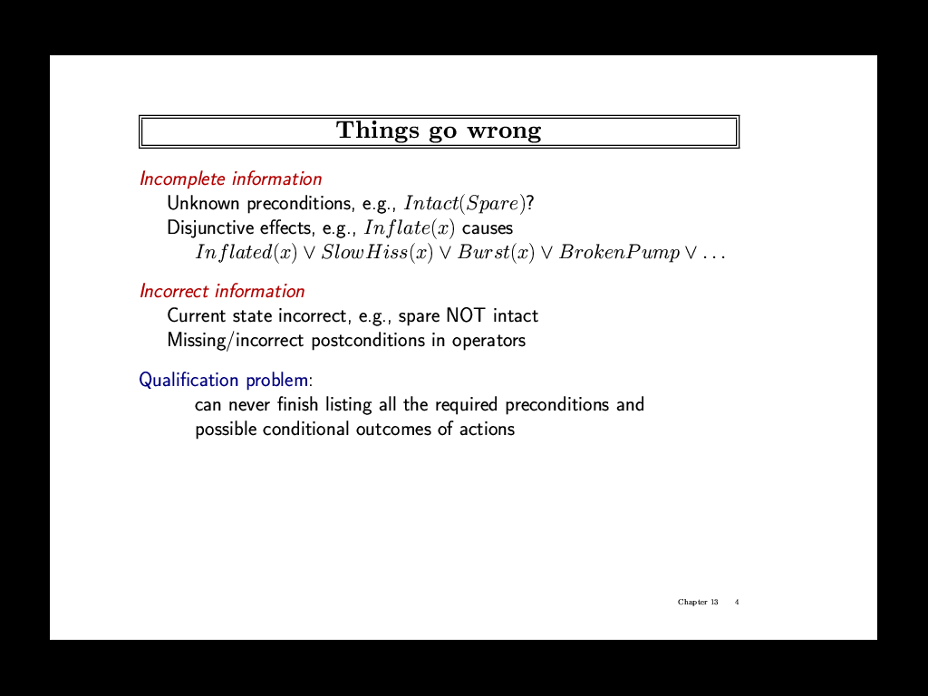

Slide 45
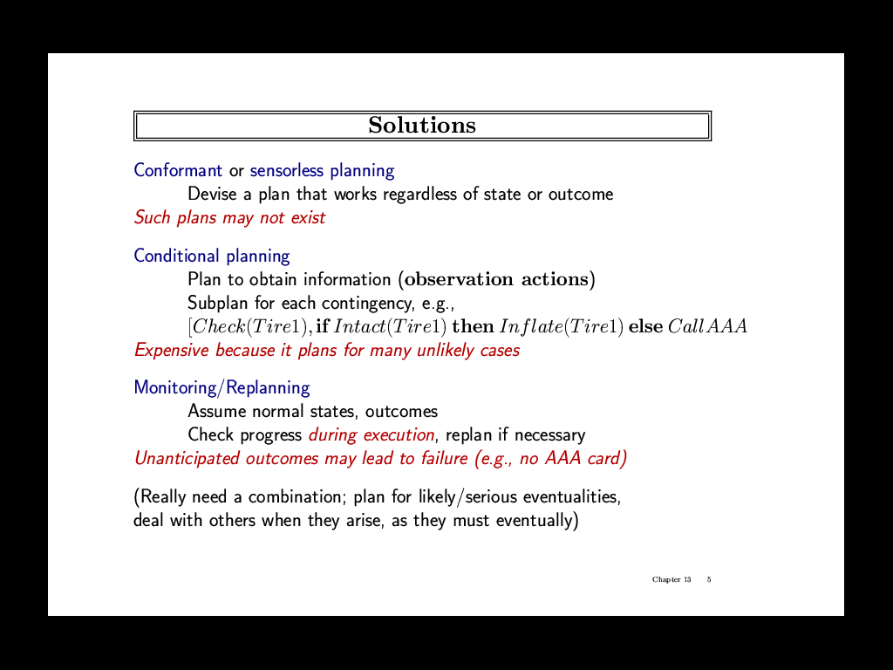

Slide 46
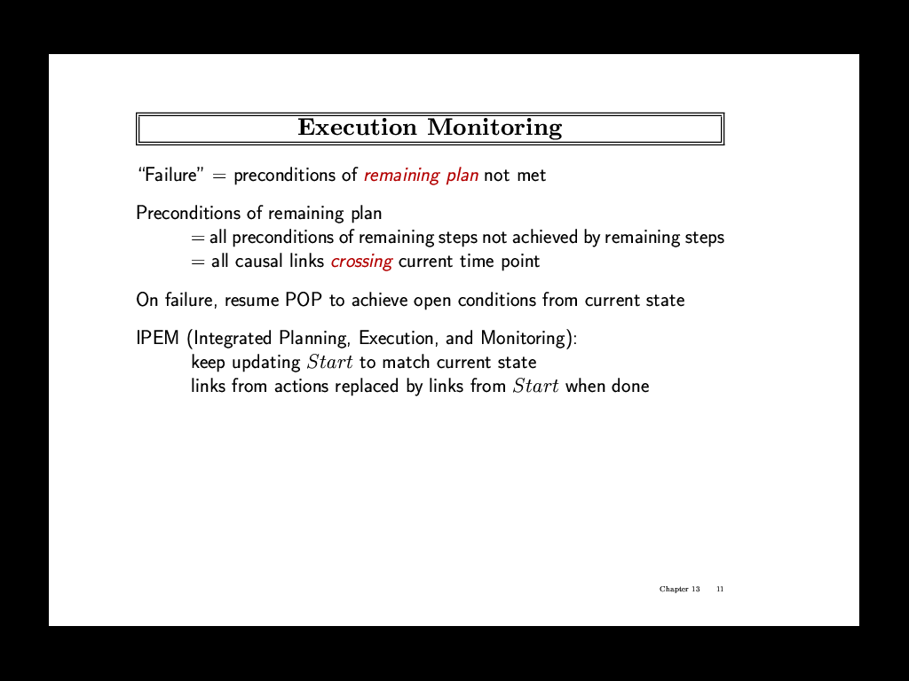

Slide 47
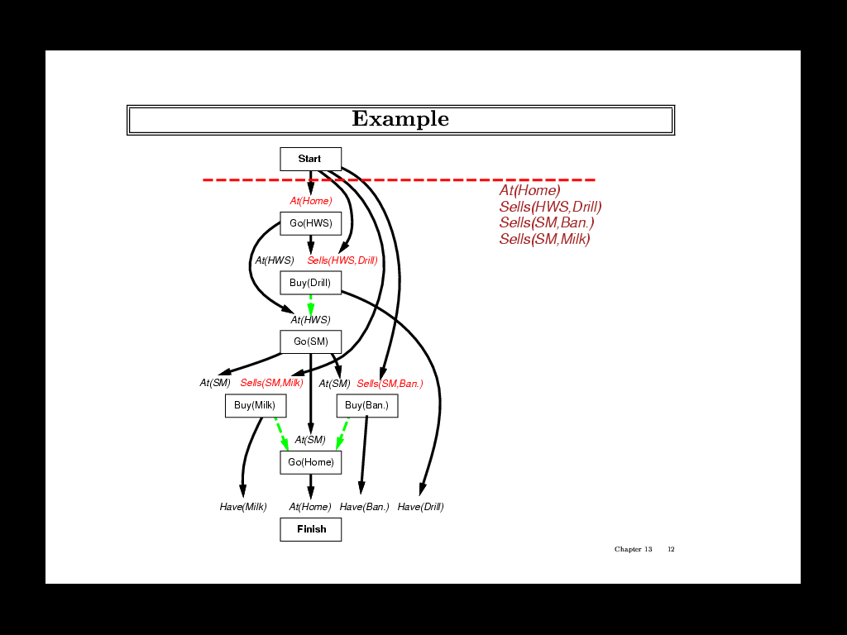

Slide 48
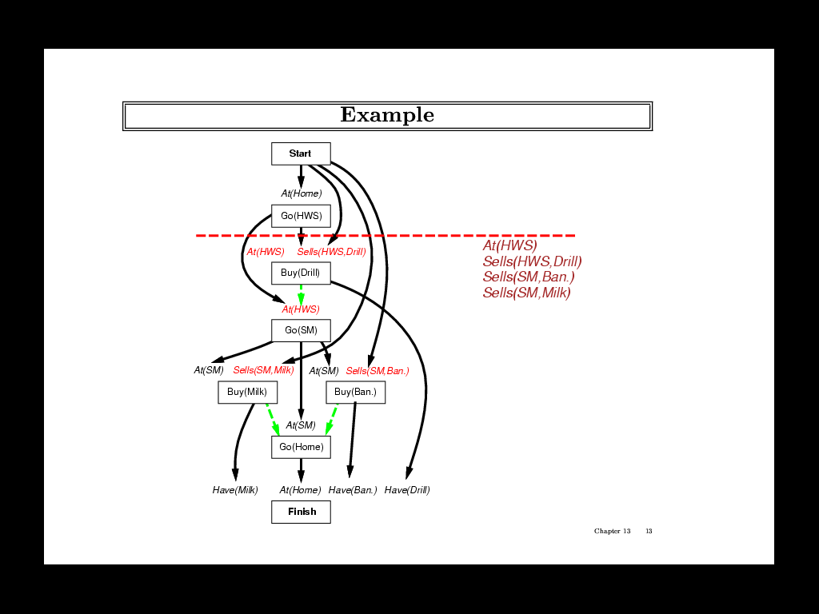

Slide 49
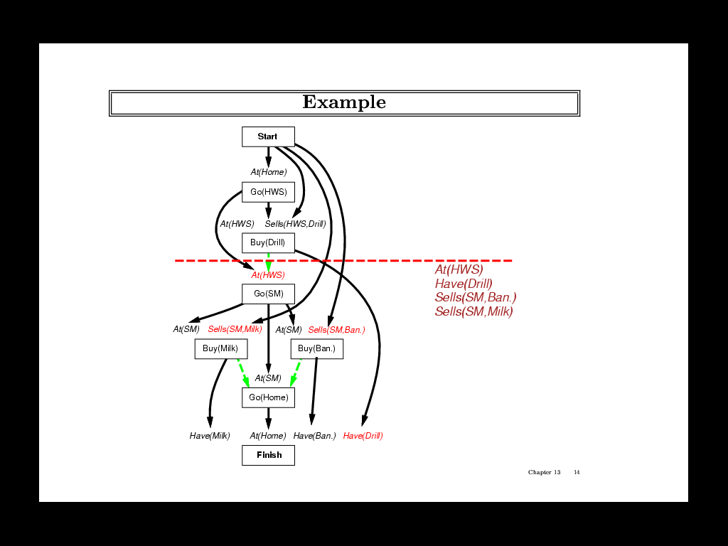

Slide 50
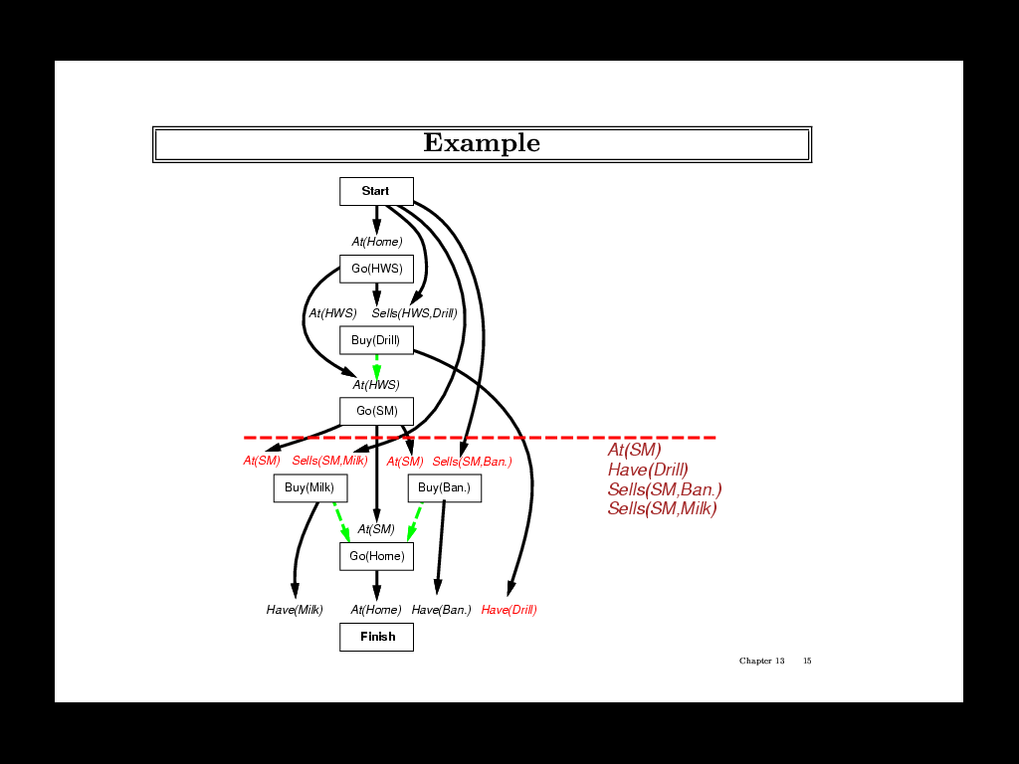

Slide 51
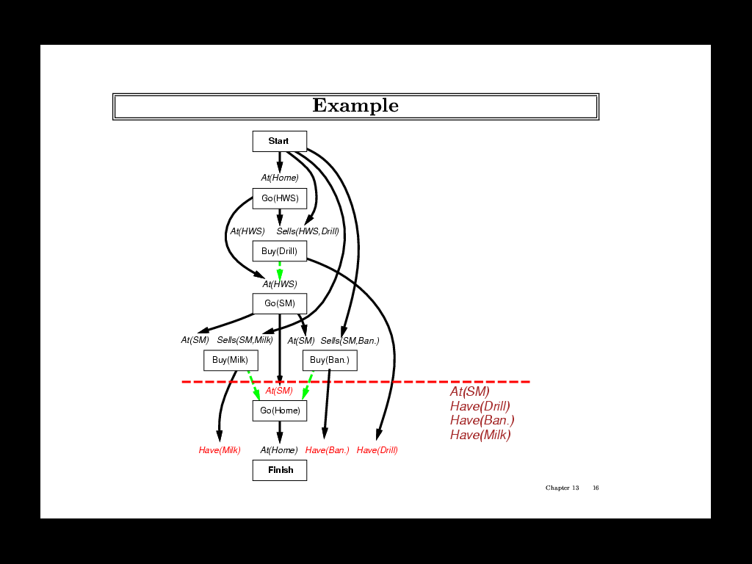

Slide 52
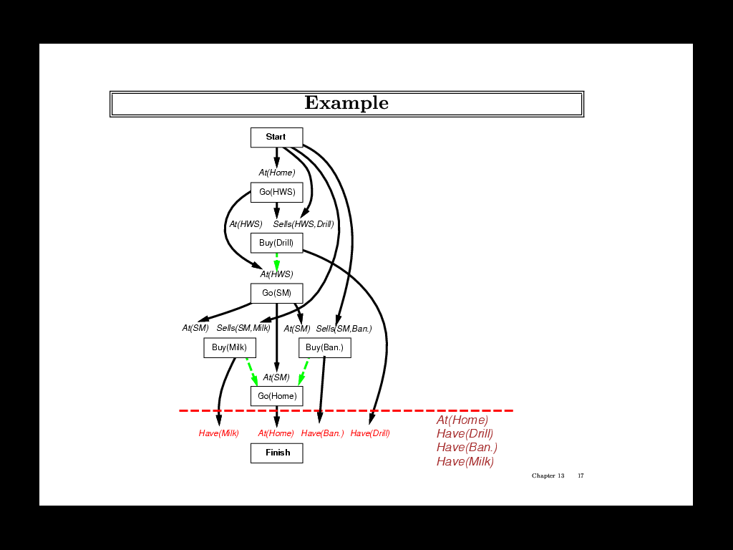

Slide 53
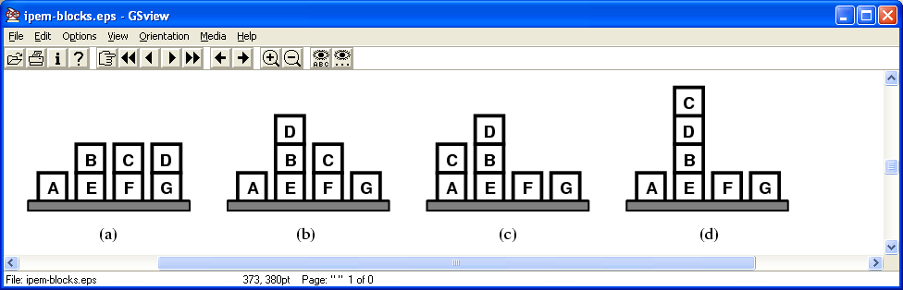
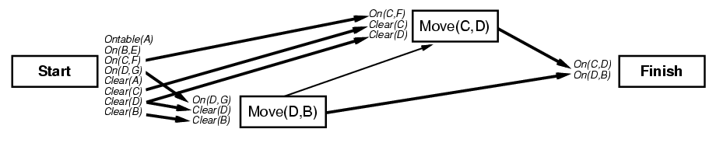
Planning & Execution
Initial State:
Move(x y)
pre: clear(x) ^ clear(y) ^ on(x z)
eff: on(x y) ^ clear(z) ^
¬on(x z) ^ ¬clear(y)
Goal:
On(C, D)
On(D, B)

Slide 54
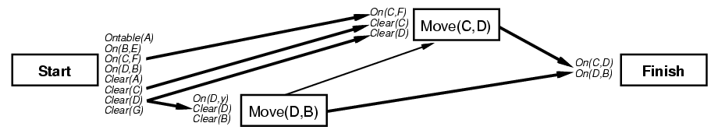
Plan ready to start execution
but genie intervenes: moves D to B !
New state of the world:
Updated plan:

Slide 55
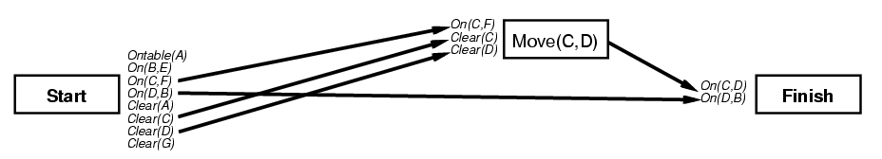
But it actually was a helpful interference:
Can link to on(D B) from current state
Move(D B) is now redundant

Slide 56
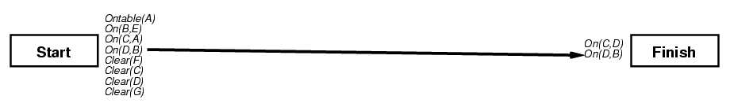
Now the agent can execute move(C D) to achieve the goal
Unfortunately our agent is clumsy and
drops C onto A instead of D
The new current state looks like:
And the updated plan is:

Slide 57
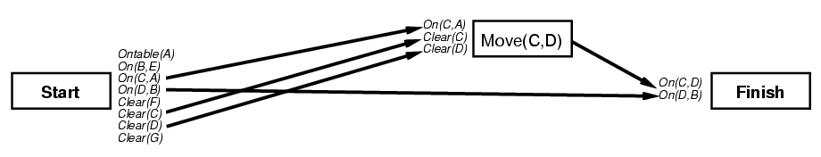
Keep planning to satisfy open condition on(C D)
Resulting plan:

Slide 58
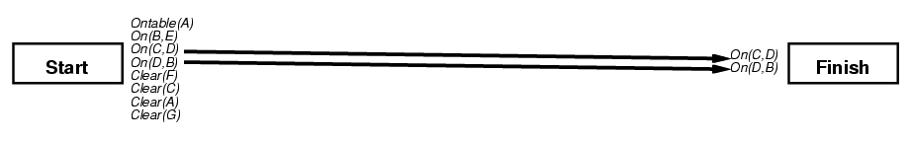
Fortunately, this time execution works:
The plan is finally completed:
Goals achieved
No threats
No unexecuted step “flaws”

Slide 59
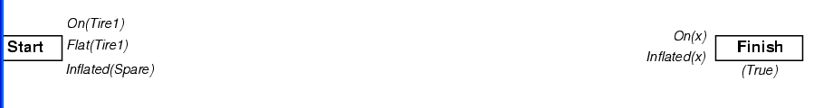
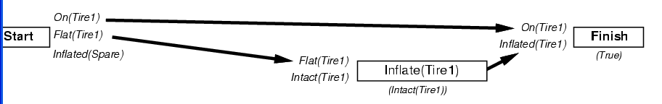
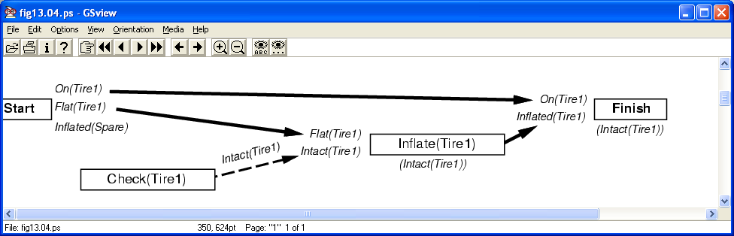
Conditional Planning

Slide 60
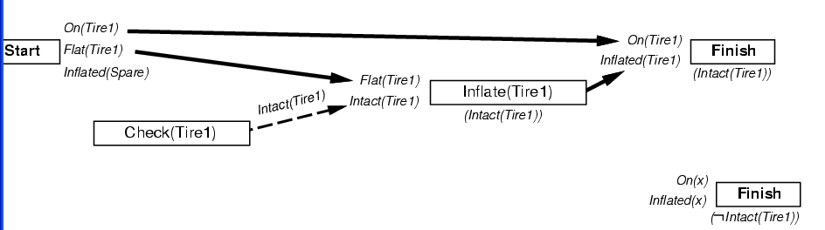
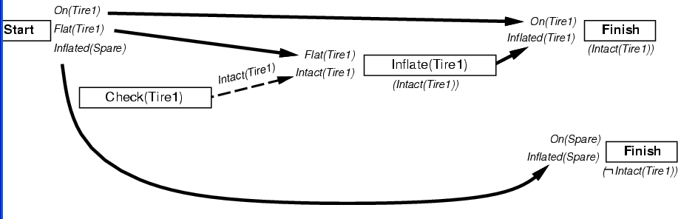

Slide 61
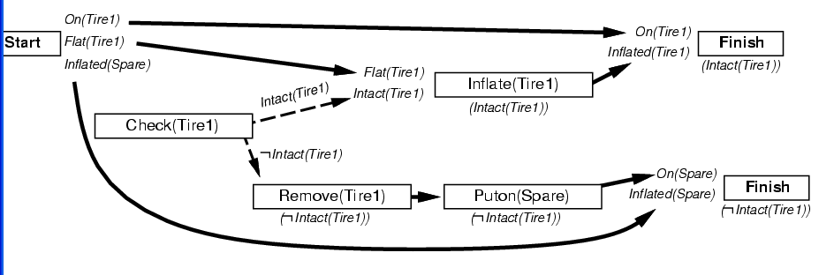

Slide 62
Planning and information gathering
UWL representation language
SENSP algorithm
Conference Discussion of: Oren Etzioni, Steve Hanks, Daniel Weld, Denise Draper, Neal Lesh, Mike Williamson (1992) "An Approach to Planning with Incomplete Information". Proceedings of the 3rd International on Principles of Knowledge Representation and Reasoning

